Slide 1

Sharing e-Resources
In the Digital Environment
Dr. H K Kaul
Director, DELNET
Developing Library Network
2018

Slide 2
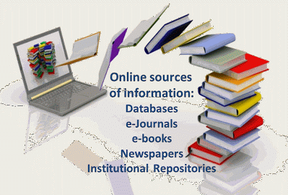
The Main Concerns
The demand for sharing educational resources electronically
Ever growing sea of information
Sharing of e-resources/ copyright regulations/
Product Licenses
Growth of digital libraries
Sharable resources
Four groups : Content, Community, Technology and Services.

Slide 3

e-Books
Regularly increasing
Several pricing models
Infrastructure for host e-books
IFLA Principles for Library e-Lending, 2013
“the right to license and/or purchase any commercially available e-book without embargo;
Reasonable terms and conditions at a fair price;

Slide 4
e-Books – IFLA Principles
Copyright limitations and library exceptions available;
e-publications should be neutral platform taking into account accessibility standards;
the ability to preserve e-books for long term; and
be able to protect the privacy of library users.”

Slide 5
Constraints and Restrictions
i. DRM controls
ii. The saving and sharing of e-books through reading devices also has been found difficult;
iii. Database model for parallel access to different e-books;
iv. Restrictions on sharing of e-books;
v. Streamlining of variable pricing models

Slide 6
Constraints and Restrictions
vi. Delayed sales;
vii. Lack of standardisation of format, hardware and software
a. Hardware: Guidance on the use of specific e-book hardware such as portable devices, desktop PCs etc.
b. Software- Guidance on hyperlinks, colour, networking features etc.
c. Making technologies more comprehensible.
viii. Formats such as Microsoft Reader, Adobe PDF, PostScript, and DAISY Digital Talking Book are equipped with DRM

Slide 7
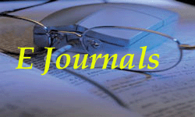
e-Journal Services
The legal issues
The archival issues,
Federated search facilities
Development of special platforms

Slide 8
Product Licensing
1. Generally non exclusive and non-transferable
2. Institution does not acquire any IPR rights in the Products software, systems, documentation etc.
3. Listing authorized users
4. Inter-library Loan and scholarly sharing provisions
Some pub. don’t allow download or creating printouts of a reasonable portions
6 Should uphold “Fair Use” and “Fair Dealing” permissions.

Slide 9

Section 108 Study Group Report-US Copyright Office, 2008
1. Limited Copyright exemptions given.
2. Section 108 does not properly cover archiving, preservation and digital delivery of documents.
3. Can’t make “a preservation copy of any at-risk” work.
4. New knowledge is developed through libraries and archives
5. The Group supported the use of digital ILL in principle;
6. To limit the further distribution of the electronic document by the user.

Slide 10

Manifesto 2007
A group of LIS experts from the US and
Canada prepared the manifesto in 2007.
The following are its main principles.
1. “Restrictions shall only be imposed as necessary by individual institutions with the goal that the lowest-possible-barriers-to-fulfillment are presented to the user.
2. “Library users shall be given appropriate options for delivery format, method of delivery, and fulfillment type, including loan, copy, digital copy, and purchase.
3. “Global access to sharable resources shall be encouraged through formal and informal networking agreements with the goal towards lowest-barrier-to-fulfillment.
4. “Sharable resources shall include those held in cultural institutions of all sorts: libraries, archives, museums, and the expertise of those employed in such places.

Slide 11
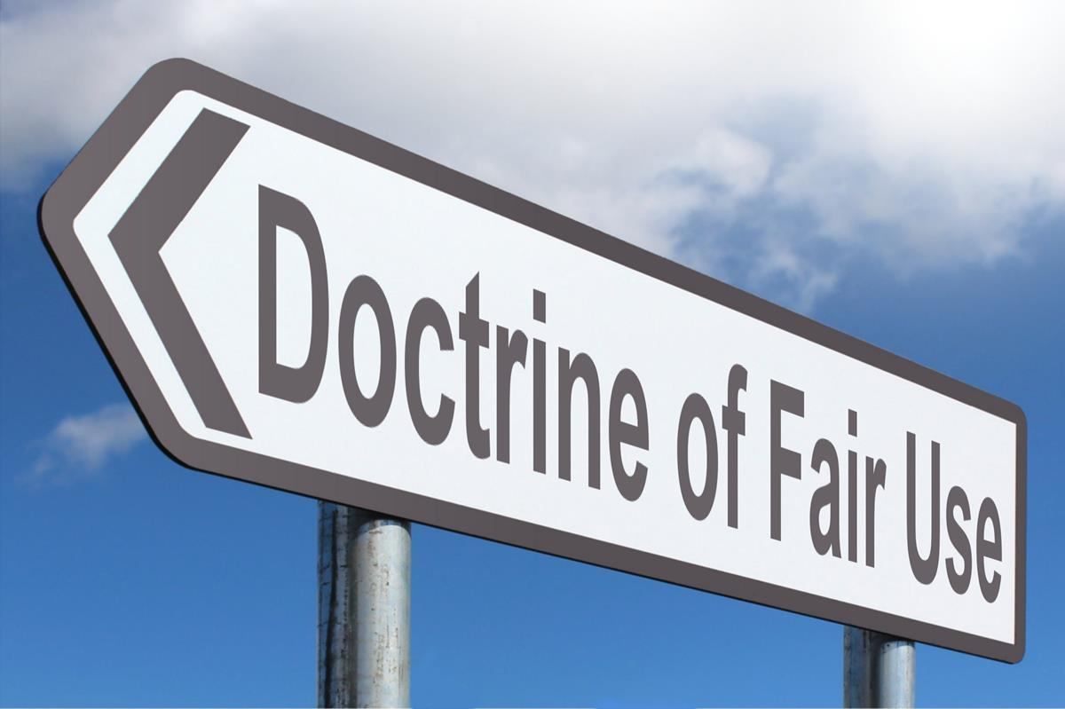
Fair Use Doctrine
Fair Use forms part of the Section 107 of the U.S. Copyright Act. Fair use of a copyrighted work is allowed for “criticism, comment, news reporting, teaching (including multiple copies for classroom use), scholarship, or research, is not an infringement of copyright.”
Indian Copyright Act, 1957
Sec. 52 (1) allows copying for private or personal use/ research.
Section 52(1)(n) allows non-commercial public libraries to store works for preservation in electronic medium.
Section 65A titled “protection against circumvention of technological measures” restricts librarians to circumvent the DRM.

Slide 12

Fair Use and ILL
ILL has to be for genuine research purposes for one researcher and not for a number of them.
DU Example
Authors/Publishers Concerns
In the digital environment the technology which is acceptable should avoid the misuse of digital resources.

Slide 13
Fair Dealing
Many Commonwealth countries including Australia, Canada, New Zealand, Singapore and United Kingdom have adopted the doctrine of Fair Dealing which allows use of the copyrighted works for certain activities without obtaining the permission of the copyright owners.

Slide 14

Human Rights for Information
The Universal Declaration of Human Rights (Article 19), International Covenant of Civil and Political Rights (Article 19) and European Convention on Human Rights (Article 10) guarantee an individual to “seek, receive and impart information and ideas through any media and regardless of frontiers.”
Rights of Libraries
ISO Inter-Library Loan Application Standards

Slide 15

1. Remove restrictions in resource sharing
2. Urgent need of using regularly DELNET resources and services
3. Collective information and collective knowledge be made sharable in the digital form.
4. The publishers should allow make downloads or creating printouts of reasonable portions of content.
5. Be able to make “a preservation copy of any at-risk” work.
6. Publishers should accept fair use policies.

Slide 16
7. Stop further distribution of the electronic documents by the users.
8. Teach users about delivery format, copyright obligations, method of delivery, fulfillment time and the necessary charges if any.
9. Library networks should get documents from global sources.

Slide 17
10. In library networks sharable resources would be those which are held by member-institutions and are issuable or available for reference.
11. Document delivery service to libraries/users should be based on respect for copyright but copyright should not act as a hindrance in making documents available for academic purposes.

Slide 18

Images used in the presentation
are courtesy google

